Slide 2
THE DISCIPLES RELATIONSHIP:
TO HIMSELF
An Athlete
A Soldier
TO HIS LORD
The Potter and the Clay
The Vine and the Branches
A Child of God
TO HIS BRETHREN
A Member of the Body
“My Brother’s Keeper”
A Servant
TO THE WORLD
Strangers & Pilgrims
Salt & Light
An Apologist
Fishers of Men

Slide 3
LESSON 10: Strangers and Pilgrims The Disciple’s Greatness
All these died in faith, without receiving the promises, but having seen them and having welcomed them from a distance, and having confessed that they were strangers and exiles on the earth. (Hebrews 11:13)

Slide 4
What does it take to live like Strangers and Pilgrims?
Faith
Heb 11:3-18
2Cor 5:7 …for we walk by faith, not by sight

Slide 5
What does it take to live like Strangers and Pilgrims?
Faith
Heb 11:6
And without faith it is impossible to please Him, for he who comes to God must believe that He is and that He is a rewarder of those who seek Him.

Slide 6
What does it take to live like Strangers and Pilgrims?
Faith
Noah – warned of things not yet seen
Abraham – not knowing where he was going
Sarah – conceived beyond the proper time

Slide 7
What does it take to live like Strangers and Pilgrims?
Faith
Noah – warned of things not yet seen
Abraham – not knowing where he was going
Sarah – conceived beyond the proper time

Slide 8
What does it take to live like Strangers and Pilgrims?
They trusted in God’s promises
Rom 4:19-21
2 Tim 1:11-12 – It is a trustworthy statement: For if we died with Him, we will also live with Him; If we endure, we will also reign with Him; If we deny Him, He also will deny us;
We must have the same trust

Slide 9
What does it take to live like Strangers and Pilgrims?
They trusted in God’s promises
Heb 11:8 – by
What situations or circumstances help us to realize we have no stake in this world and we must trust in God to care for us?
[I am thinking sickness, loss of job, death of loved one or child, or where obedience cost us our job, job, friends, other relationships,…]

Slide 10
What does it take to live like Strangers and Pilgrims?
They obeyed God’s instructions
Heb 11:8 – by faith Abraham obey God
Walking – living, doing
Even when we cannot see the end
Even when it might not make good, common or financial sense
Faith moves us to action - James 2:18-26

Slide 11
What does it take to live like Strangers and Pilgrims?
Faith
Believed God’s promised
Did not think of the country they came from
Sought a country of their own, better, heavenly

Slide 12
What does it take to live like Strangers and Pilgrims?
Matt. 20:17-28 (Mark 10:32-45)
Gk. “diakonos” (vs. 26, 28v) – servant/minister
one who executes the commands of another, especially a master; attendant
Rom. 1:1; Phil. 2:7; 2Tim. 2:24; Act. 6:2 (sim.)
Gk. “doulos” (vs. 27) – slave/servant
one who gives himself up to another’s will; devoted to another to the disregard of one’s own interests;
Rom. 15:8; 1Tim. 4:6; 1Pet. 4:10; Gal. 5:13 (sim.)

Slide 13
A Servant – Definition and “Greatness”
Matt. 20:17-28 (Mark 10:32-45)
Becoming “great” means…
World
Power
Authority
First
Spiritual
Serve
Humility
Last

Slide 14
A Servant – Definition and “Greatness”
Matt. 20:17-28 (Mark 10:32-45)
“sit on Your right and one on Your left” (vs. 21)
“the ten became indignant with the two brothers” (vs. 24)
“…the Son of Man will be delivered to the chief priests and scribes, and they will hand Him over to the Gentiles to mock and scourge and crucify Him…” (vss. 18-19)
“the Son of Man did not come to be served, but to serve, and to give His life a ransom for many.” (vs. 28)

Slide 15
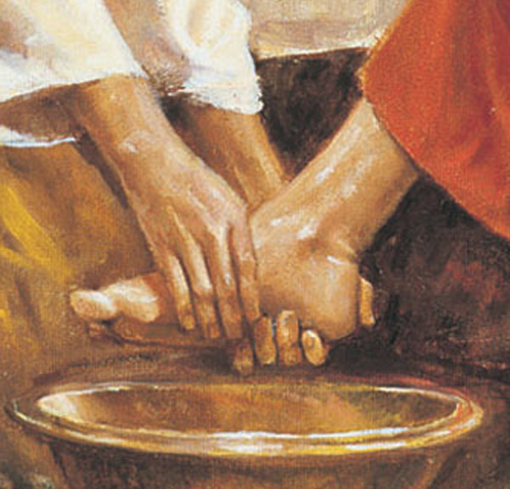
Jesus, the Great Example
John 13:1-17, Luke 22:14-27
“Do you know what I have done to you? You call Me Teacher and Lord; and you are right, for so I am. If I then, the Lord and the Teacher, washed your feet, you also ought to wash one another’s feet. For I gave you an example that you also should do as I did to you.” (John 13:12-15)
“And there arose also a dispute among them as to which one of them was regarded to be greatest” (Luke 22:24)

Slide 16
Jesus, the Great Example
John 13:1-17, Luke 22:14-27
“…the kings of the Gentiles lord it over them; and those who have authority over them are called ‘Benefactors.’ But it is not this way with you, but the one who is the greatest among you must become like the youngest, and the leader like the servant. For who is greater, the one who reclines at the table or the one who serves? Is it not the one who reclines at the table? But I am among you as the one who serves.” (Luke 22:24-27)

Slide 17
Jesus, the Great Example
Phil. 2:1-11
“…who, although He existed in the form of God, did not regard equality with God a thing to be grasped, but emptied Himself, taking the form of a bond-servant, and being made in the likeness of men…” (vss. 6-7)
“He humbled Himself by becoming obedient to the point of death…” (vs. 8)
God highly exalted Him, and bestowed on Him the name which is above every name…” (vs. 9)

Slide 18
How to Be a Good Servant - Attitude
Phil. 2:1-11
Humility
“make my joy complete by being of the same mind, maintaining the same love, united in spirit, intent on one purpose” (vs. 2)
“Do nothing from selfishness or empty conceit, but with humility of mind regard one another as more important than yourselves.” (vs. 3)

Slide 19
How to Be a Good Servant - Attitude
Love, Kindness, Gentleness…
“with all humility and gentleness, with patience, showing tolerance for one another in love…” (Eph. 4:2)
“…as those who have been chosen of God, holy and beloved, put on a heart of compassion, kindness, humility, gentleness and patience; bearing with one another, and forgiving each other, whoever has a complaint against anyone; just as the Lord forgave you, so also should you.” (Col. 3:12-13)

Slide 20
How to Be a Good Servant - Attitude
Is this a “favor for favor”?
What if they don’t display any appreciation?
What if I don’t think they deserve for me to be loving, kind, patient…?
“Slaves, in all things obey those who are your masters on earth, not with external service, as those who merely please men, but with sincerity of heart, fearing the Lord. Whatever you do, do your work heartily, as for the Lord rather than for men, knowing that from the Lord you will receive the reward of the inheritance.” (Col. 3:22-24)

